Slide 1
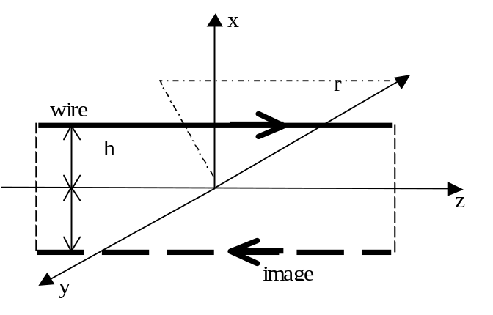


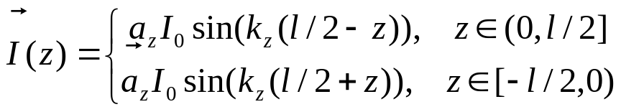


Beverage or long wire antenna above PEC ground
Formulation used in the Matlab program “beverage” to get:
characteristic impedance Z0 directivity D0 radiation resistance R angles of maximum radiation angles of null radiation in the pattern radiation pattern
The program consider two cases:
Resonant wire, current distribution
Traveling wave, current distribution
The factor K is used below , such as

Slide 2
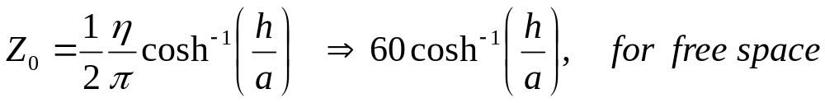

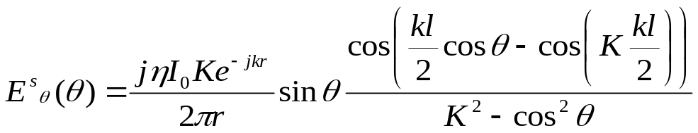
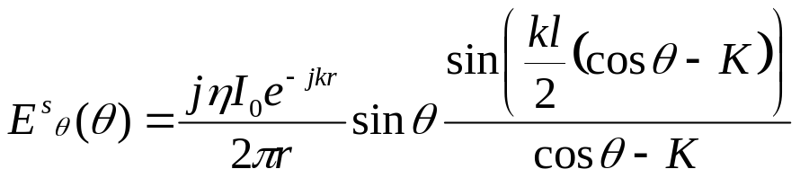

Characteristic Impedance for the beverage antenna
is obtained from the one of a two wire line (p. 117, [2]) using the image theory
Far-Zone Electric field
Where
Resonant case
Traveling wave case
For both cases using ( [1] 6-52, 6-52a, 6-54, 6-54a, pp. 283-285)

Slide 3
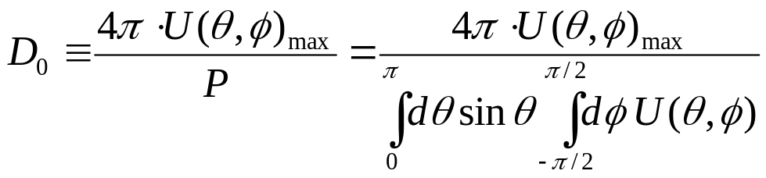
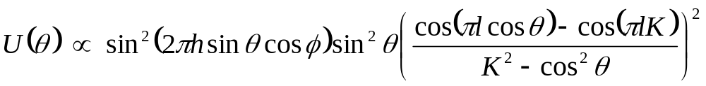
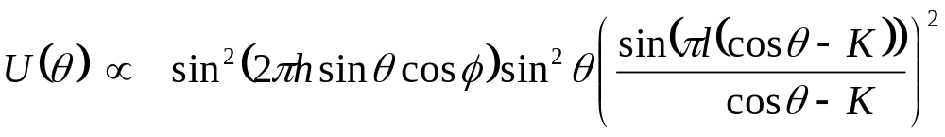
Directivity
where dimensions are in wavelength
for resonant case:
for traveling wave case:

Slide 4
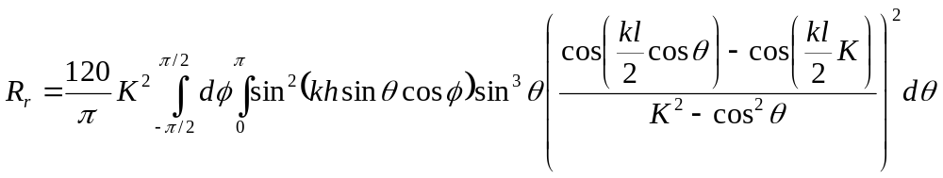
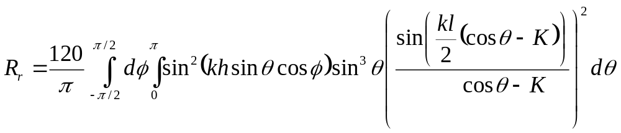
Radiation Resistance.
Taking into account that
For radiation into free space we have
Resonant case:
Traveling wave case:

Slide 5
Note Expressions for Far-Zone Electric field are obtained as follows.
E-field of a single wire is obtained using formulas (4-57, 4-58, 4-58a, p. 152, [1]) and taking into account particular current distribution.
Approximations used for the distance R are (4-46, p. 148, [1]).
Total electric field in far-zone is obtained with image theory and (6-52, 6-52a, 6-54, 6-54a, pp. 283-285, [1])
References:
[1] C. E. Balanis, Antenna Theory: Analysis and Design, John Willey & Sons, 1997.
[2] R.E.Collin, Foundation for Microwave Engineering, McGraw-Hill,1996.

